Slide 1
DYNAMIC PRICING PROBLEM
Quantitative Decision Making for Business Operations TU Berlin Summer School 2018
Keshigeyan | Arturo | Nick | Rahul | Rafael | Ali

Slide 2
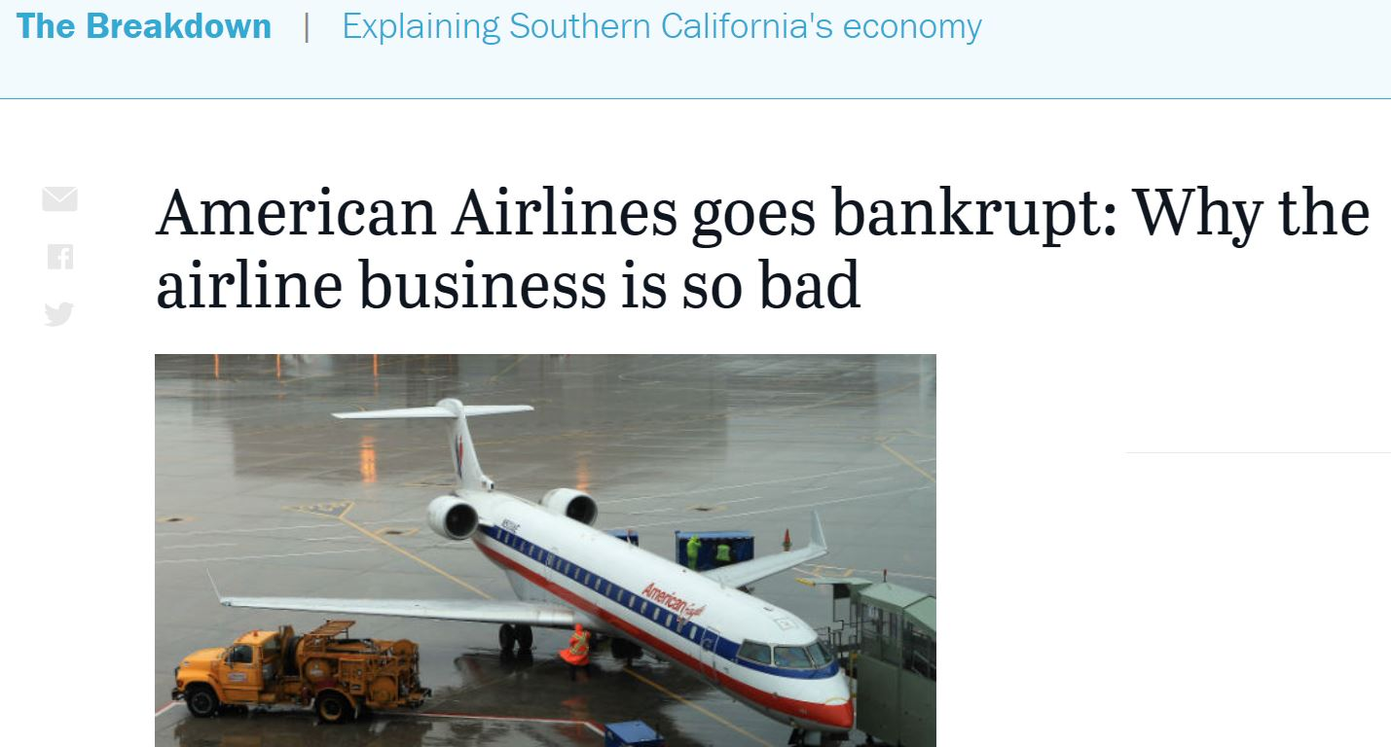
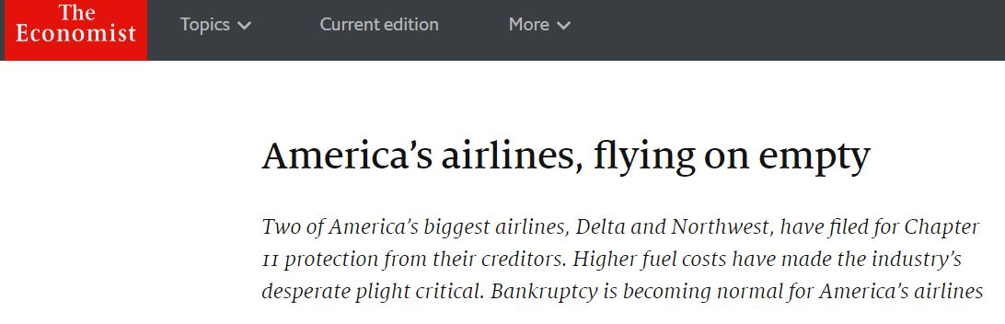
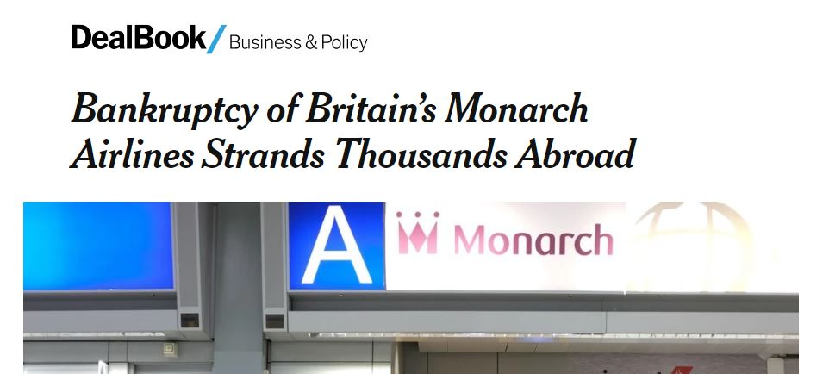

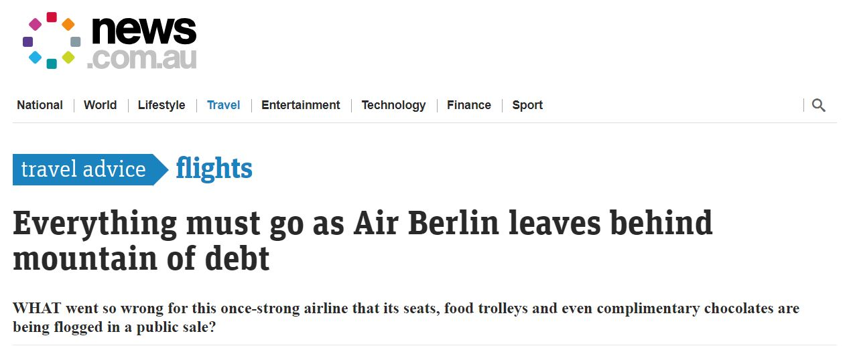
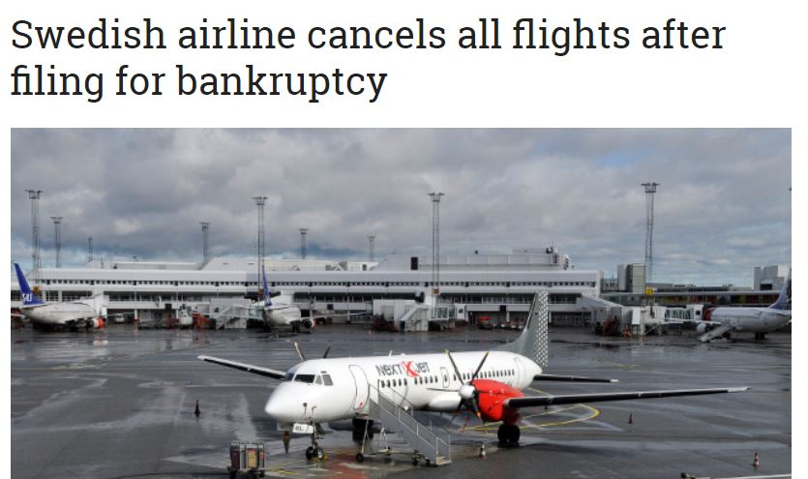
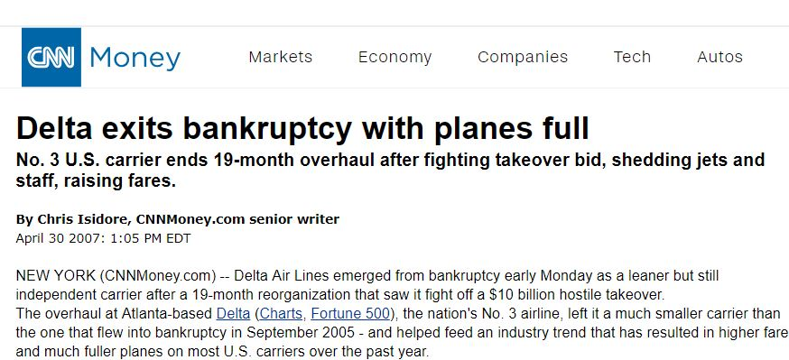
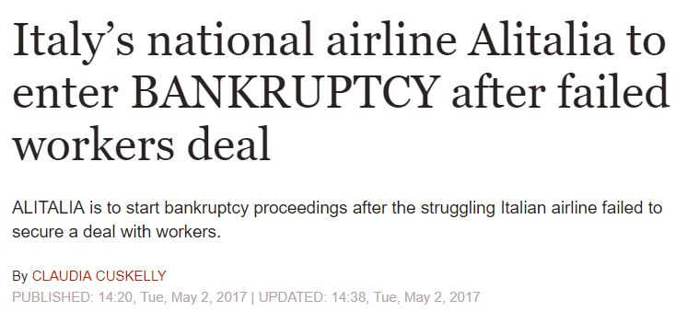

Slide 3
Industry at a glance
“Airline industries have strictly proven themselves to be historical laggards and are prone to serious bankruptcies”
“It’s one of the most enduring folk wisdom dicta in all of commerce that the airline industry, in its history has never made money”

Slide 4
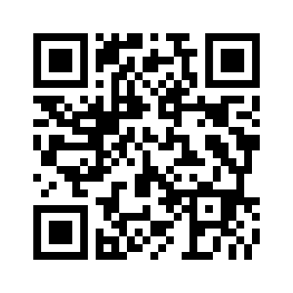
Pre-requisites
EMSR
Demand Curves
Consumer Surplus
Jupyter Notebook: https://www.kaggle.com/keshik/tub-c6

Slide 5
Expected Marginal Seat Revenue version-a (EMSR-a)
It is a statistical model that tries to maximize revenue by applying booking limit / protection levels to seats.
The basic idea of a booking limit is to avoid selling a seat to a customer with lower purchase power compared against high purchase power customer.
One protects the higher class (one keep seats for H) until the “expected value of the seat in class H” goes below the price of the seat in class L where H is the higher fare class.

Slide 6
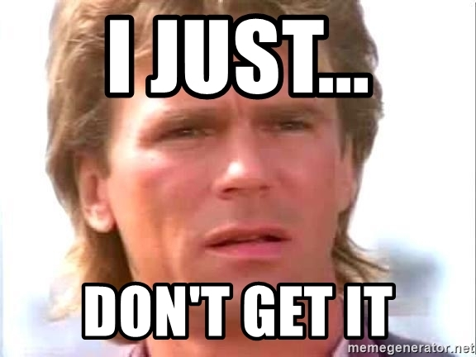

Slide 7


EMSR ??
Statistical Model
Protection Levels
Understanding Consumers
Price Discrimination
Exploit consumers surplus

Slide 8
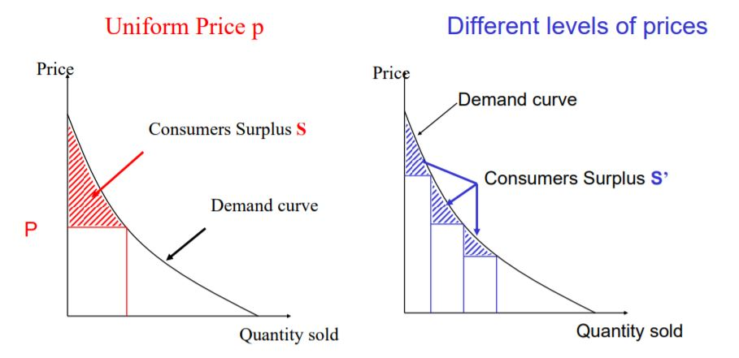
Demand Curves and Consumer Surplus

Slide 9
Project objective
Air Innovation wants to be pioneer in the air transport industry by creating a new sales strategy that gives them an advantage over its competitors. Therefore they started and in-house competition were all employees have the possibility of submitting proposals. The proposals have to focus on strategies that helps exploits the consumers “willingness to pay” and the employee with the best proposal will receive a juicy bonus.

Slide 10

Mark Mustermann (data analyst): Increasing the number of price points will reduce the revenue lost through consumers’ surplus. Hence the revenue is directly increased.
Gabi Glamour (sales expert): Use the EMSR to calculate the maximum expected seat value of each seat and interpret it as a minimal accepted fare and exclude the protection levels.
Lazy Mike (nobody knows what he does in the company): Propose a combination of both Marks and Gabis idea.
After receiving many proposals, Air Innovations have selected 3 proposals to be analysed:

Slide 11
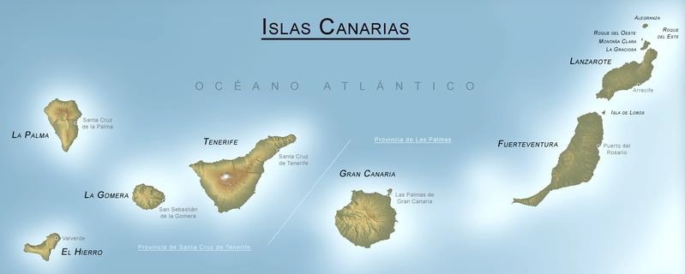

Slide 12
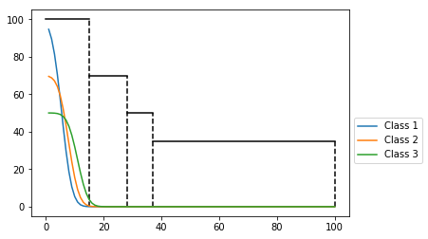
Analysis and Visualizations
Baseline Revenue Model:
Number of fare classes = 4
Fares = [100, 70, 50, 35]
Capacity = 100
Fare range = $25 - $550
Fare Class | Protection limit
100 | 15
70 | 13
50 | 9
35 | 63
Maximum Revenue = $5065
Notes:
Guys why do we have protection limit for fare class 35 here in the above slide ??

Slide 13

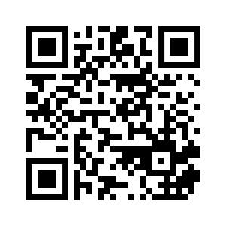
Bets !!!!!!!
https://www.surveymonkey.co.uk/r/ZRYMRHC

Slide 14
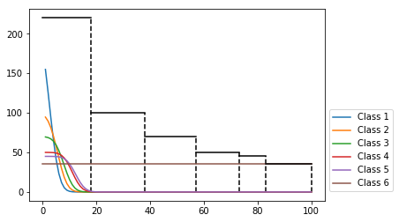
Number of fare classes = 6
Fares = [220, 100, 70, 50, 45, 35]
Capacity = 100
Fare range = $25 - $550
Marks Revenue Model
Attempt 1
Fare Class | Protection limit
220 | 18
100 | 20
70 | 19
50 | 16
45 | 10
35 | 17
Refine
Get feedback
Maximum Revenue = $9135
% Increase in Revenue compared to baseline = 80.36%

Slide 15
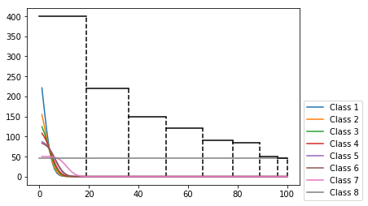
Number of fare classes = 8
Fares = [400, 220, 150, 120, 90, 85, 50, 45]
Capacity = 100
Fare range = $25 - $550
Marks Revenue Model
Attempt 2
Fare Class | Protection limit
400 | 19
220 | 17
150 | 15
120 | 15
90 | 12
85 | 11
50 | 7
45 | 4
Refine
Get feedback
Maximum Revenue = $17935
% Increase in Revenue compared to baseline = 254.1%
% Increase in Revenue compared to attempt 1 = 96.33%

Slide 16
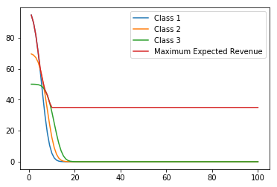
Gabis Revenue Model
Number of fare classes = 4, Fares = [100, 70, 50, 35], Capacity = 100
Maximum Revenue = 3759.5, % Increase in Revenue compared to baseline = -25.8 %

Slide 17
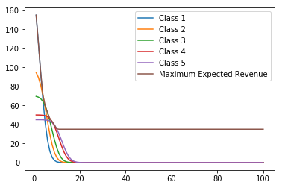
‘Lazy’ Mike’s Revenue Model
Number of fare classes = 6
Fares = [220, 100, 70, 50, 45, 35]
Capacity = 100
Fare range = $25 - $550
Attempt 1
Fare Class | Protection limit
220 | 18
100 | 20
70 | 19
50 | 16
45 | 10
35 | 17
Maximum Revenue = $3870.57
% Increase in Revenue compared to baseline = -23.58%

Slide 18
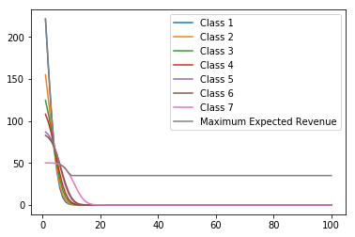
‘Lazy’ Mike’s Revenue Model
Number of fare classes = 8
Fares = [400, 220, 150, 120, 90, 85, 50, 45]
Capacity = 100
Fare range = $25 - $550
Attempt 2
Fare Class | Protection limit
400 | 19
220 | 17
150 | 15
120 | 15
90 | 12
85 | 11
50 | 7
45 | 4
Maximum Revenue = $3988.11
% Increase in Revenue compared to baseline = -21.26%

Slide 19
Let’s see the survey result!

Slide 20
Who gets the bonus????
 | Mark | Gabi | Mike
Pros | Generating higher revenue when demands can be forecasted. Can perform better for short-term planning purposes. | This method can potentially estimate revenue values more closer to the actual demand. Might work if the demand is unknown. | Aggregated benefits from both Mark and Gabi’s idea. Can potentially work for long-term purposes since the demand cannot be accurately forecasted.
Cons | EMSR-a will calculate protection limits that are too conservative. In other words, it will reserve too many seats for the higher fares, thereby rejecting too many low fare bookings. Customer arriving order unknown. | Can result in lower revenue values if the expected revenue curves are very steep. | Might generate less revenue compared to EMSR-a method.
Notes:
ex. In high season, in general, demands will be high. Customers are more willing to adjust their WTP anyhow to buy the tickets.
ex. In low season, customers are less willing to adjust their WTP. It is better to sell each seat at its expected price, rather than unifying it to the higher price.

Slide 21





Conclusion of Findings: Short term
Mark
Gabi
Lazy Mike

Slide 22
Conclusion of Findings: Long Term
Mark
Gabi
Lazy Mike

Slide 23

Q & A

Slide 24
References
http://leea.recherche.enac.fr/Enseignements/PricingRM2011.pdf
https://en.wikipedia.org/wiki/Expected_marginal_seat_revenue
https://edition.cnn.com/travel/article/airline-pricing-secrets/index.html
https://www.news.com.au/travel/travel-advice/flights/remembering-the-ghosts-of-airlines-past/news-story/2a6255786d6c4facc9f33bb1092a10a3
https://isis.tu-berlin.de/pluginfile.php/972736/mod_resource/content/2/07082018_Topic_Revenue_Management.pdf

